Slide 1
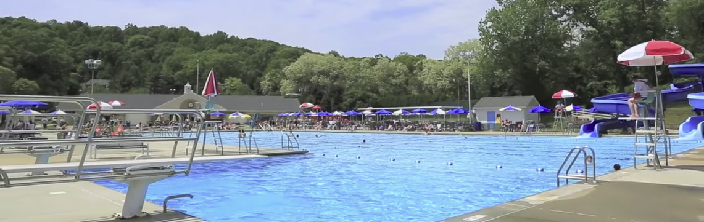
Pool Utility Update
Township of Verona
Presentation to the Mayor and Council
November 10, 2025

Slide 2

Presentation Agenda
Pool Utility Study Background
Recommended 2026 – 2028 Fees
Pool Utility Fund Balance Forecast
2025 Pool Utility Results

Slide 3
Pool Utility Study background

Slide 4
Study Background
In 2024, NewGen was tasked with developing forecasts to achieve a self-liquidating Pool Utility. Key elements included:
  Loss of American Rescue Plan Act funds ($200,000).
  Potential for pilot program to include Out-of-Town Family memberships.
  Addition of water purchases, buildings and grounds, and recreation costs not typically included in the Pool Utility.
Based on NewGen’s recommendation, the Council adopted a 15% increase in pool membership fees for 2025.
  Planned phase-in of fee increases to use $140,000 of Pool Utility Fund Balance over three years to stabilize rates.
  Did not include Out-of-Town Family memberships.

Slide 5
NewGen’s 2024 Pool Fee Forecast
 | 2024 | 2025 | 2026 | 2027 | 2028 | 2029
Percent Change | 15% | 15% | 10% | 3% | 3% | 3%
Dollar Change (Family) | $85 | $90 | $70 | $25 | $25 | $25
Membership Fee
Couple | $547 | $630 | $695 | $715 | $735 | $755
Family | $605 | $695 | $765 | $790 | $815 | $840
Caregiver | $150 | $175 | $195 | $200 | $205 | $210
Firefighter | $ - | $ - | $ - | $ - | $ - | $ -
Parent and Child | $518 | $595 | $655 | $675 | $695 | $715
Individual | $397 | $455 | $500 | $515 | $530 | $545
Twilight | $236 | $270 | $295 | $305 | $315 | $325
Senior Citizen | $195 | $225 | $250 | $260 | $270 | $280

Slide 6
2025 Update Scope of Work
NewGen was tasked with updating the Pool Utility’s financial model:
  Actual 2025 Operating Costs and Revenues
  Actual 2025 memberships
  Estimated end of 2025 Pool Utility Fund Balance
Develop a new three-year forecast of Pool Membership fees that includes Out-of-Town Family memberships.

Slide 7
2025 Pool Results

Slide 8
2025 Forecasted vs.
2025 Actual Pool Results
(nearest 1,000) | Forecasted | Actual | Difference
Salaries and Wages | $401,000 | $354,000 | ($47,000)
Electricity and Chemicals | $78,000 | $90,000 | $12,000
Other Costs | $93,000 | $96,000 | $3,000
Water Purchases | $53,000 | $45,000 | ($8,000)
Buildings and Grounds | $18,000 | $0 | ($18,000)
Recreation | $16,000 | $0 | ($16,000)
Capital Projects / Reserves | $50,000 | $79,000 | $29,000
Debt Service | $333,000 | $334,000 | $1,000
Total Costs | $1,040,000 | $997,000 | ($43,000)
Membership Fees | $958,000 | $774,000 | ($184,000)
Other Revenues | $49,000 | $109,000 | $60,000
Total Revenues | $1,008,000 | $883,000 | ($125,000)
Fund Cash Flow | ($33,000) | ($114,000) | ($81,000)

Slide 9
Updated Recommendations

Slide 10
Key Items Impacting NewGen’s Updated Forecast
Items already included in 2024 forecast:
  Payoff of Series 2013 debt in 2026 (-$127,000).
  Removal of Emergency Authorizations in 2026 (-$90,000).
  Splash Pad debt service beginning in 2027 (+$153,000).
  Big Pool Replastering debt service beginning in 2027 (+$54,000).
  Basketball Court Improvements debt service beginning in 2028 (+$9,000).
New Items included in 2025 forecast:
  Addition of 100 Out-of-Town Family memberships at a fee of $1,000 each.
  Bond funding of $50,000 for Repairs to Main Building (+$8,500).
  One-time increase in Furniture replacement in 2026 (+$45,000).

Slide 11
Updated 2025 Pool Fee Forecast
 | 2025 | 2026 | 2027 | 2028
Percent Change (Inside Fees) | 15% | 2% | 2% | 2%
Dollar Change (Family) | $90 | $14 | $14 | $14
Membership Fee
Couple | $629 | $642 | $655 | $668
Family (Inside Town) | $696 | $710 | $724 | $738
Family (Outside Town) | N/A | $1,000 | $1,100 | $1,200
Caregiver | $173 | $176 | $180 | $184
Firefighter | $0 | $0 | $0 | $0
Parent and Child | $596 | $608 | $620 | $632
Individual | $457 | $466 | $475 | $485
Twilight | $271 | $276 | $282 | $288
Senior Citizen | $224 | $228 | $233 | $238

Slide 12
Cash Flow Forecast

Slide 13
Updated Cash Flow Forecast
(nearest 1,000) | 2025 | 2026 | 2027 | 2028
Salaries and Wages | $354,000 | $370,000 | $388,000 | $407,000
Electricity and Chemicals | $90,000 | $93,000 | $96,000 | $99,000
Other Costs | $96,000 | $94,000 | $98,000 | $101,000
Water Purchases | $45,000 | $47,000 | $48,000 | $50,000
Buildings and Grounds | $0 | $61,000 | $64,000 | $66,000
Recreation | $0 | $0 | $0 | $0
Capital Projects / Reserves | $79,000 | $5,000 | $75,000 | $62,000
Debt Service | $334,000 | $333,000 | $231,000 | $240,000
Total Costs | $997,000 | $1,003,000 | $1,000,000 | $1,025,000
Membership Fees | $774,000 | $891,000 | $922,000 | $959,000
Other Revenues | $109,000 | $112,000 | $113,000 | $113,000
Total Revenues | $883,000 | $1,003,000 | $1,036,000 | $1,073,000
Fund Cash Flow | ($114,000) | $0 | $36,000 | $48,000

Slide 14
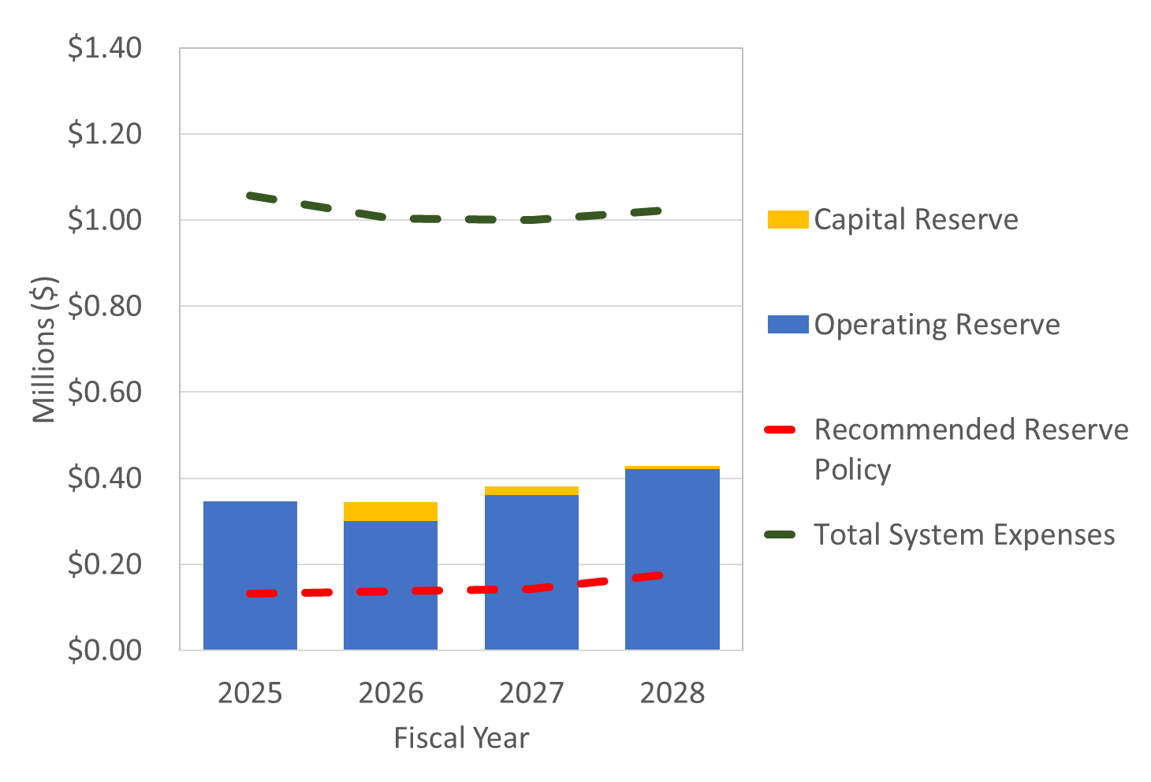
Pool Fund balance Forecast Under Recommended Fees

Slide 15

Thank you!
Eric Callocchia
ecallocchia@newgenstrategies.net

